Slide 1
The Korean Situation and International Relations in Northeast Asia
Unification Academy 통일아카데미
April 9, 2013
Sung Chull Kim

Slide 2
Questions
In Northeast Asia, does economic interdependence increase (or lessen) political cooperation?
What has made the inter-state relations in Northeast Asia entangled and complicated?
What is the background of North Korea’s (peculiar) behavior today?
What is the nature of the inter-Korean relations now, and what kind of relations do we have to establish the relations?

Slide 3
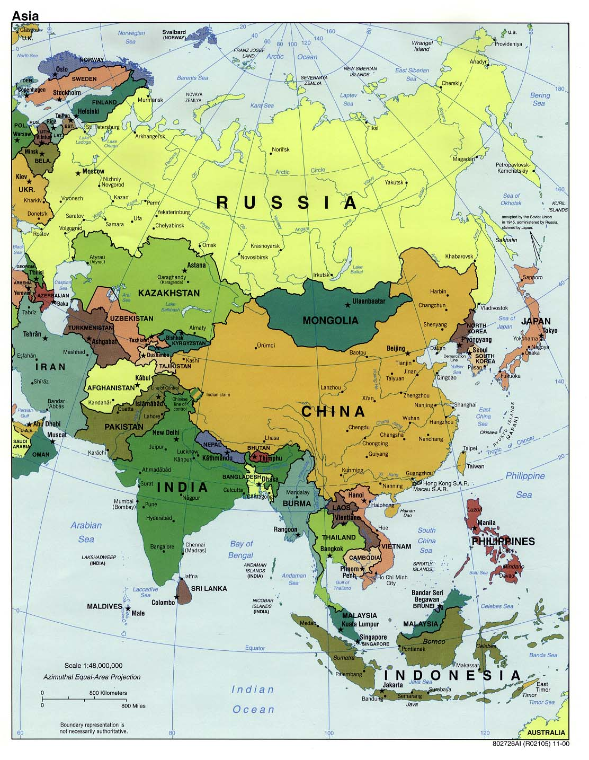
Notes:
냉전기 양극체제하, 미국의 소련 봉쇄전략, 전선으로서의 한국, 한-미-일 삼각관계, 동맹관계 위계, 모호성 존재
냉전 직후, 미국 일국체제 -> 양극체제 이행, 중국의 부상

Slide 4
Some facts (2012)
CIA world factbook (GDP, purchasing power parity)
country | space | Pop (million) | capital | GDP (million US dollars) | GDP/capita (US dollars)
China | 9,597 | 1,349 | Beijing | 12,380,000 | 9,100
Japan | 378 | 127 | Tokyo | 4,525,000 | 36,200
Russia | 17,080 | 142 | Moscow | 2,504,000 | 17,700
U.S. | 9,630 | 316 | Washington DC | 15,650,000 | 49,800
North Korea | 121 | 24 | Pyongyang | *40,000 | *1,800
South Korea | 99 | 48 | Seoul | 1,611,000 | 32,400

Slide 5
Transitions of inter-state relations in Northeast Asia
Cold War period
  US strategy of containment of the Soviet Union: wedge between SU and China
  US-Korea-Japan relations: alliance, hierarchy, ambiguity (history and territory)
    US, Japan—legalistic
    Korea—moralistic, historical
Post-Cold War period
  US unipolar → US-China rivalry and cooperation
    China’s increasing influence
  NEA is the theater of the US-China relations
  Changes in US-Korea-Japan relations
    Controversies on ambiguous legacy of the Cold War

Slide 6
Challenges in the region
Strategic divergence
  China’s rise vs. U.S.-Japan alliance
  Danger of arms race (nuclear proliferation?)
Cold War legacy on the Korean peninsula
  North Korea’s path to nuclear statehood
  Sanctions on North Korea
Remaining historical controversy
  Territorial disputes; increasing China’s ambition on maritime influence
  Comfort women, Yasukuni issue
  History textbook
Increasing resource demand
  “Energy nationalism”
  China’s oil demand: doubled between 1999 and 2004; world 2nd for consumption in 2003
Democratization (or democratic consolidation)
  Human rights

Slide 7
Contentious Issues
 | Historical Context | Strategic Context
China | Diaoyu/Senkaku South China Sea | China-U.S. relations Expansion of maritime influence (South China Sea, East China Sea)
Japan | Northern Islands, Takeshima/Dokdo, | Coping with China (South China Sea, East China Sea) Japan-U.S. alliance, collective self-defense Constitution revision or reinterpretation
South Korea | Japan’s colonial rule Dokdo/Takeshima | Coping with North Korea S.K.-U.S. alliance China’s growing influence; assertive Japan
North Korea | Anti-Americanism | Nuclear state status Approach to U.S., Japan

Slide 8
Mutual Attitudes
 | “Our culture is superior” | “We must protect against foreign influence” | “Parts of other countries belong to us”
India | 74 | 61 | 60
Turkey | 57 | 69 | 40
Bangladesh | 63 | 62 | 54
Pakistan | 50 | 52 | 51
China | 21 | 27 | N/A
Japan | 29 | 20 | 23
South Korea | 33 | 30 | 22
U.S. | 23 | 30 | 9
Russia | 23 | 35 | 26
Britain | 9 | 20 | 10
France | 10 | 24 | 5
Italy | 14 | 28 | 13
Germany | 8 | 17 | 9

Slide 9
Military expenditure
Million US dollars (constant 2005 prices & exchange rates)

Slide 10
Military expenditure
(percentage of GDP)

Slide 11
Opportunities in the region
Economic interdependence
  See Table
Increased interest in soft power
Cultural exchanges
Multilateral mechanisms
  See Diagram

Slide 12
Trade relations, 2010 (million USD; %)
(Source: Source: http://www.jetro.go.jp/)
 | partners | trade volume | export | import
Japan | China USA South Korea China+SK | 301,886 185,369 90,594 392,480 | 149,086 (19.4) 118,199 (15.4) 62,053 (8.1) 211,139 (27.5) | 152,800 (22.1) 67,170 (9.7) 28,541 (4.1) 181,341 (26.2)
China | EU USA Japan South Korea Japan+SK | 479,712 385,342 297,768 207,170 504,938 | 311,235 (19.7) 283,304 (18.0) 121,061 (7.7) 68,771 (4.4) 189,832 (12.1) | 168,477 (12.1) 102,038 (7.3) 176,707 (12.7) 138,399 (9.9) 315,106 (22.6)
South Korea | China Japan USA China+Japan | 188,412 92,472 90,219 280884 | 116,838 (25.1) 28,176 (6.0) 49,816 (10.7) 145,014 (31.1) | 71,574 (16.8) 64,296 (15.1) 40,403 (9.5) 135,870 (31.9)

Slide 13
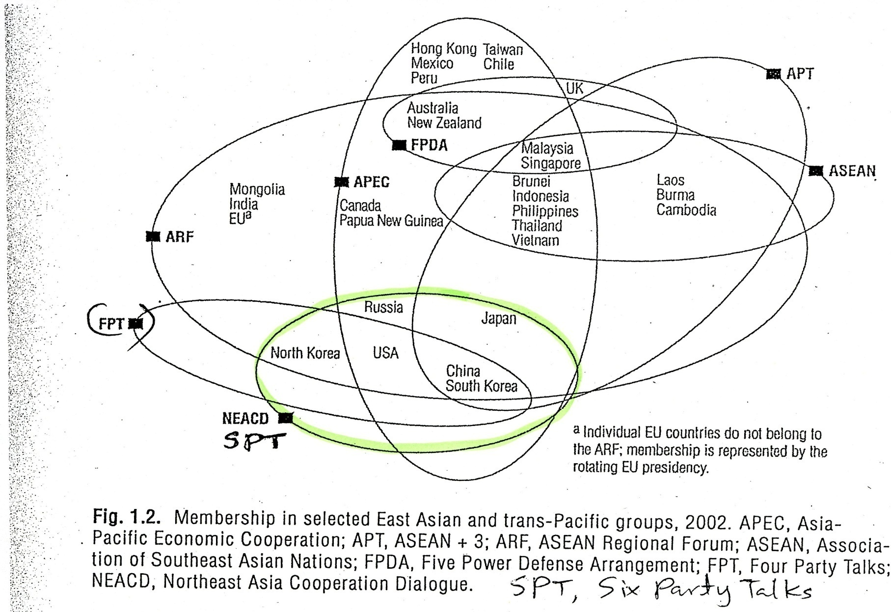
Multilateralism for regional cooperation

Slide 14
North Korea, Laboratory of IR, CP
  Nuclear weapons development (military balance; proliferation)
  Geopolitics, alliance relations (NK-China, Korea-US-Japan, US-China)—entrapment, abandonment, tethering, asymmetry
  Multilateral talks
  Human rights (political prison)
  Refugees (escapees, or defectors)
  Humanitarian aid (aid and development)
  Identity (between SK and NK; between defector groups)

Slide 15
Historical portrait of the North Korean nuclear crisis
1953: North Korea-Soviet Union atomic energy cooperation agreement
1974: North Korea joins IAEA
1985: North Korea joins NPT
1991: (1) South-North Basic Agreement; (2) South-North Joint Declaration of the Denuclearization of the Korean peninsula
1992: IAEA inspects nuclear facility at Yongbyon and concludes there are inconsistencies in North Korea's nuclear declaration.
1993: North Korea’s exit of NPT (the first nuclear crisis)
1994: Former President Carter visits North Korea; Kim Il Sung offers to freeze North Korea's nuclear program in return for high-level talks between the U.S. and North Korea.
1994: U.S. and North Korea conclude the Geneva Agreed Framework

Slide 16
Historical portrait of the North Korean nuclear crisis (continue)
2000: Inter-Korean summit
2002: Japan-DPRK summit and “Pyongyang Declaration”
2002: North Korea confesses its nuclear project based on highly enriched uranium (HEU) to James Kelly, special envoy from the United States
2003: North Korea declares the exit from NPT (the second nuclear crisis)
2003: Six-Party Talks started to solve the North Korean nuclear crisis—engagement at the multilateral level
2005: Joint Statement
Notes:
Participants of Six-Party Talks: North Korea, China, Russia, Japan, South Korea, U.S.
- China’s active role for moderating especially the differences between North Korea and the United States
1. verifiable denuclearization of the Korean peninsula
2. mutual respect sovereignty between US and NK and steps for normalization
3. economic cooperation in energy, trade, investment
4. joint effort for pace and prosperity in Northeast Asia
5. “action for action” (quid pro quo)

Slide 17
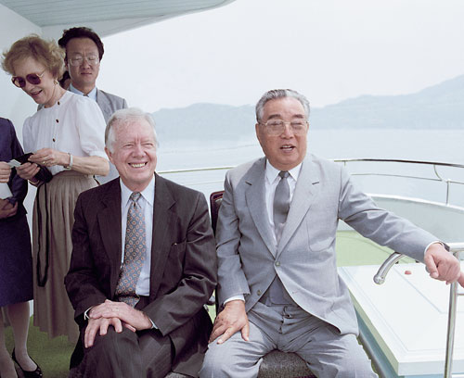

Slide 18
Historical portrait of the North Korean nuclear crisis (continue)
2005: US financial sanctions on North Korea bank accounts Banco Delta Asia in Macao—24 million dollars
2006: North Korea’s missile launches, followed by UNSC resolution 1695
2006: North Korea’s 1st nuclear test, followed by UNSC resolution 1718
2007: February agreement at the Six-Party Talks
- Lift of U.S. financial sanction against North Korean accounts in Banco Delta Asia
- 1 million tons of heavy oil aid
2007 July: Shutdown of nuclear facilities in North Korea since July 2007
2007 Nov.: Starting disablement of nuclear facilities
2008 Jun.: Declaration of nuclear program

Slide 19
Historical portrait of the North Korean nuclear crisis (continue)
2009 April: North Korea’s controversial rocket launch, followed by UNSC Chairman statement
2009 May: North Korea’s 2nd nuclear test, followed by UNSC resolution 1874 in June
2012 April: North Korea’s long range rocket launch, followed by UNSC Chairman statement
2012 Dec.: North Korea’s successful rocket launch (Eunha 3), followed by UNSC resolution 2087/ North Korea’s declaration of scrapping of the denuclearization of the Korean peninsula
2013 Feb.: North Korea’s 3rd nuclear test, followed by UNSC resolution 2094 in March

Slide 20
Differing strategies on NK nuclear issue
 | Goals | Type | Domestic relevance | Logic | Instruments
Japan | ▪ Resolution to abduction issue, ▪ Denuclearization | ▪ Conditional | high | ▪ Pressure, ▪ Dialogue | ▪ Sanctions
U.S. | ▪ Nonproliferation, ▪ Denuclearization | ▪ Conditional | low | ▪ Pressure, ▪ Negotiation, ▪ Disciplining | ▪ Sanctions
Russia | ▪ Influence on the peninsula, ▪ Denuclearization | ▪ Unconditional to conditional | low | ▪ Persuasion and pressure, ▪ Arbitration in differences
China | ▪ Influence on the peninsula (geopolitical significance), ▪ Denuclearization? | ▪ Unconditional to conditional | Low, but increasing | ▪ Persuasion and pressure, propping up | ▪ Economic aid and trade
South Korea | ▪ North Korea’s “internationalization” ▪ Denuclearization | ▪ Conditional | high | ▪”Trusting-building process” | ▪ Coordination with U.S., humanitarian engagement

