Slide 1
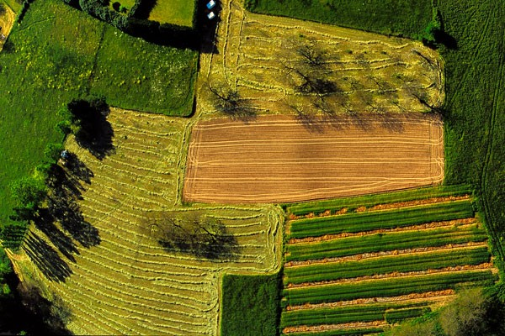
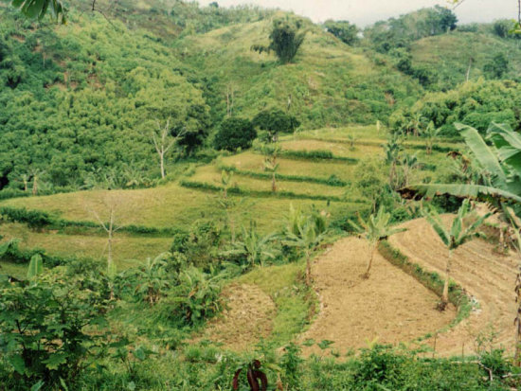
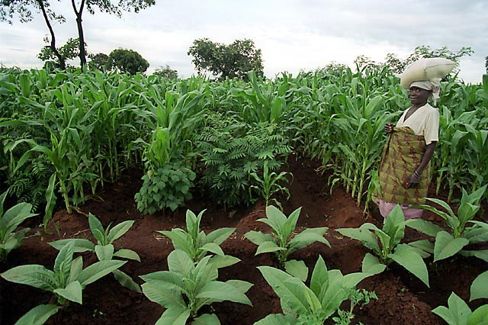
Agroecology and Climate Change:
Necessary Strategies for Adaptation and Mitigation
Albie Miles, Ph.D.
Assistant Professor
Sustainable Community Food Systems
University of Hawai‘i, West O‘ahu
albie@hawaii.edu
Notes:
Perhaps a image of 1 or more DFS here to give people a few ideas of what an DFS looks like?

Slide 2
Outline:
Climate Change and Agriculture: Anticipated impacts and the contribution of agriculture to global climate change;
Biologically Diversified Farming Systems: Key Findings on Ecosystem Services and Productivity;
Implications for Climate Change Adaptation and Mitigation
Political Context

Slide 3
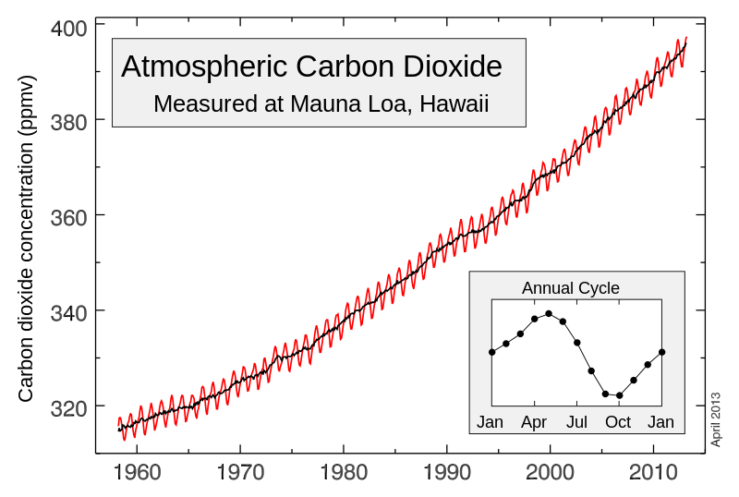
Tend in Atmospheric CO2 Concentrations:
Current (mean): 403.26ppm. Target: 350ppm
NOAA 2015: http://www.esrl.noaa.gov/gmd/ccgg/trends/
Notes:
Source NOAA: http://www.esrl.noaa.gov/gmd/ccgg/trends/weekly.html

Slide 4
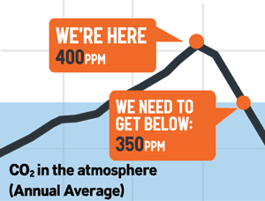
Carbon Dioxide Concentrations
Source: 350.org

Slide 5
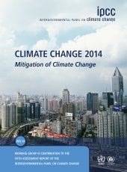
United Nations Intergovernmental Panel on Climate Change Report (2014)
Key Findings of the 2014 UN IPCC Report:
Very strong evidence that climate change is taking place on land and sea globally;
Greenhouse gases have driven up global temperatures and extreme weather;
Climate change threatens global food supply by threatening sources of food and water due to extreme weather events;
Climate change is already impacting food production and food price volatility.
UN IPCC (2014): http://www.ipcc.ch/
Notes:
U.N. Climate Panel Issues Dire Warning of Threat to Global Food Supply, Calls for Action & Adaption: http://www.democracynow.org/2014/4/2/un_climate_panel_issues_dire_warning

Slide 6
Implications of Study in the Context of the United Nations Intergovernmental Panel on Climate Change Report (2014):
Key findings of the 2014 UN IPCC Report:
“…if the world does nothing to mitigate emissions of greenhouse gases, and the extent of climate change continues to increase, then the very social stability of human systems could be at stake.”
- Rajendra Pachauri, Chair of the IPCC
Calls for immediate action for adaption and mitigation.
UN IPCC (2014): http://www.ipcc.ch/
Notes:
U.N. Climate Panel Issues Dire Warning of Threat to Global Food Supply, Calls for Action & Adaption: http://www.democracynow.org/2014/4/2/un_climate_panel_issues_dire_warning

Slide 7
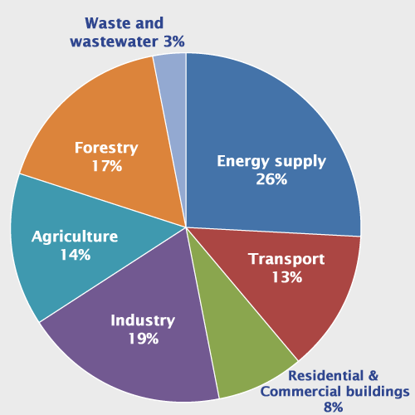
Global Greenhouse Gas Emissions by Sector
Agriculture and the food system is responsible for an estimated 40% of global GHG emissions – the largest driver of climate change.
Source: UN IPCC (2007); Foley 2010, 2012.
Notes:
US EPA: http://www.epa.gov/climatechange/ghgemissions/global.html

Slide 8
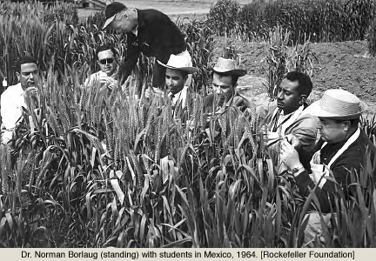
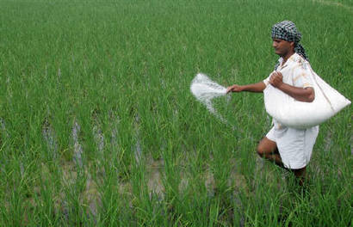
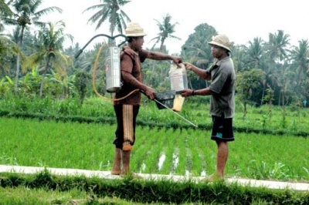
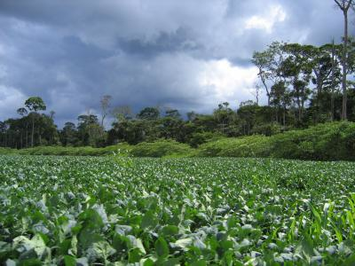
Development and Deployment of “Green Revolution” Technologies: 1940-Present
High-yielding crop varieties
Concentrated mineral fertilizers: nitrogen and phosphorus
Synthetic chemical pesticides
Irrigation water
Mechanization
Perkins 1990; Evenson and Gollin 2003; Vandermeer 2011; Pingali 2012.
Notes:
Growing out of the concerns of overpopulation, hunger and the American strategy of Cold War containment, high rates of investment from the Rockefeller and Ford foundations were channeled into agricultural research driving the innovations in technology that came to be know as the Green Revolution. First in Mexico (1941) then later in India (1956), agricultural technologies were developed and integrated as necessary technological packages that included HYV, synthetic chemical N and P, pesticides, mechanical tillage and irrigation. These initial innovation were further developed and deployed through a vast network of international agriculture research centers and the American LGU system.
Early History: The Mexican Agricultural Program: What would later be called the Green Revolution began as the Mexican Agricultural Program (MAP), which was started by the Rockefeller Foundation at the suggestion of then U.S. Vice President Henry A. Wallace in early 1941.[3] Wallace suggested Mexico needed "greater agricultural production."[4] MAP was a joint effort by the Rockefeller Foundation and the Mexican government for two decades, during the 1940's and 1950's. The program set up research stations around Mexico for corn, wheat, sorghum, barley, livestock, beans, potatoes, and feed grains. Of these crops, only corn and beans were a major staple in Mexican diets. For more information, see the article on the Mexican Agricultural Program.CriticismIn 1970, Dr. Gunnar Myrdal, a Swedish economist and social scientist, said:"Measures to improve yields in agriculture in underdeveloped countries will not be effective without radical reforms [chiefly redistribution of land ownership and tenancy," he said, yet "even the discussion of land reform has been toned down and has almost disappeared from agricultural planning.""A bigger problem, he continued, is that in underdeveloped countries - where the farm population runs as high as 70 per cent - the introduction of labor-saving technology to spur crop production would greatly increase unemployment and thereby aggravate poverty and malnutrition."Even foreign aid, by obviating increased local agricultural production, he said, "could make political, social and economic conditions still more precarious and indeed, unbearable.""The solution, he suggested, is for such countries to promote high-yield agriculture that would also require much man-power, adding that in India, for one, "It is a disquieting fact that there are no indications of either policy or research being directed toward this combined objective."[5]
The Rockefeller Foundation and the green revolution, 1941–1956: http://www.springerlink.com/content/h537072505l37466/

Slide 9
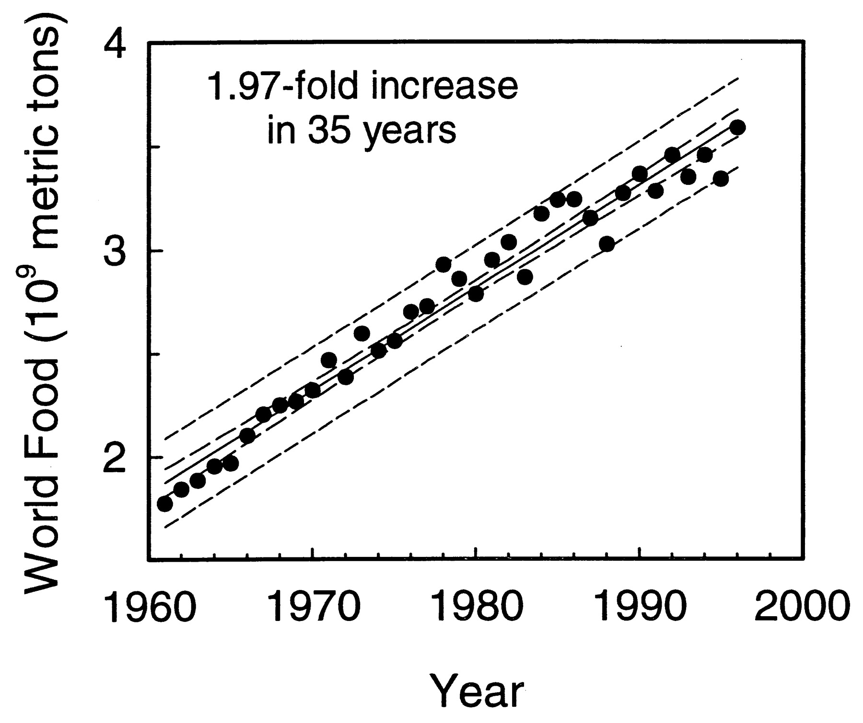
World food production - measured as the sum of cereals, coarse grains and root crops - almost doubled from 1961 to 1996.
Tilman D PNAS 1999;96:5995-6000
©1999 by National Academy of Sciences
Notes:
Based on FAO data (1), world food production, measured as the sum of cereals, coarse grains and root crops, almost doubled from 1961 to 1996. A linear regression, and 95% and 99% confidence intervals for the regression, are shown.

Slide 10
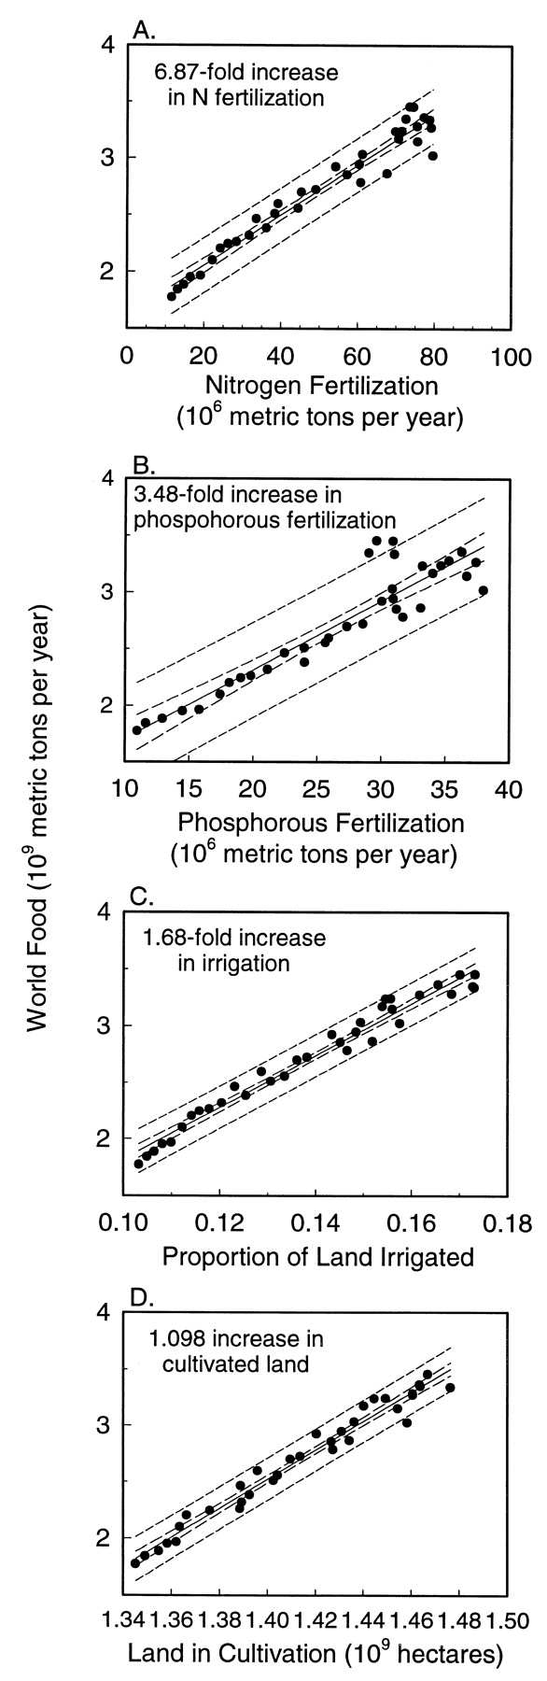
The relationship between annual global *food production and agricultural inputs (FAO data).
*cereals, coarse grains, root crops
Tilman D PNAS 1999;96:5995-6000
©1999 by National Academy of Sciences
Notes:
The relationship between annual global food production (cereals + coarse grains + root crops) and agricultural inputs, based on FAO data (1). (A) Global annual nitrogen fertilization rate. (B) Global annual phosphorus fertilization rate. (C) Proportion of arable lands that are irrigated. (D) Total land surface in agricultural crop production.

Slide 11
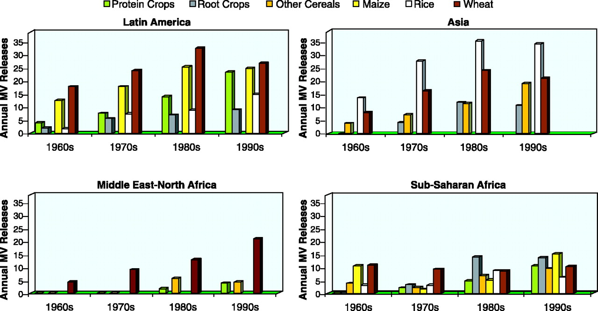
The relationship between annual global food production and agricultural inputs: high yielding modern varieties
©1999 by National Academy of Sciences
Evenson, R. E. and Gollin, D. 2003. Assessing the impact of the Green Revolution, 1960 to 2000. Science 300(5620):758-762.
Notes:
Based on FAO data (1), world food production, measured as the sum of cereals, coarse grains and root crops, almost doubled from 1961 to 1996. A linear regression, and 95% and 99% confidence intervals for the regression, are shown.

Slide 12
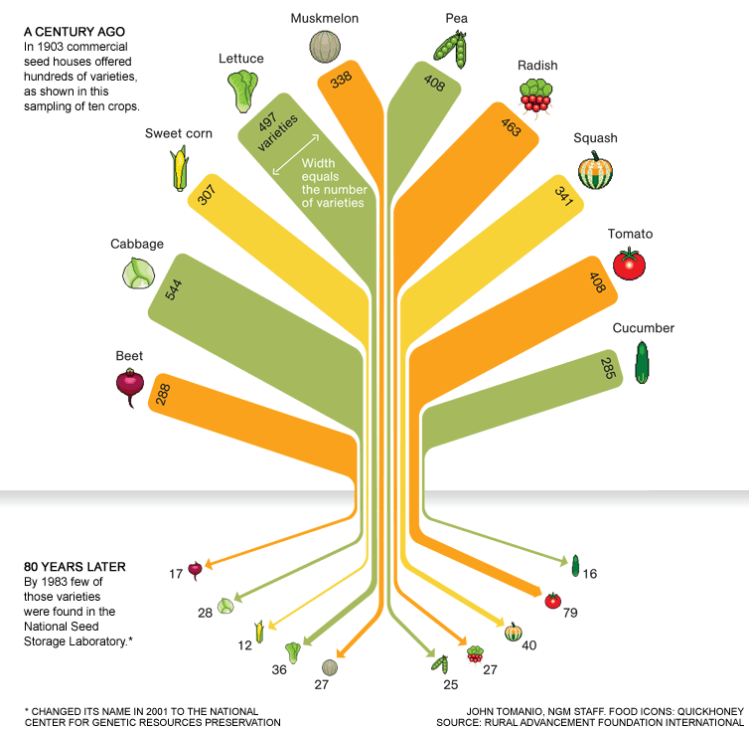
The loss of agro-biodiversity
Thrupp, L. A. (2000). Linking agricultural biodiversity and food security: the valuable role of agrobiodiversity for sustainable agriculture. International affairs, 76(2), 283-297.
Notes:
Monoculture are defined by the planting of a single crop species over extensive tracks of land, and characterized by an absence of crop rotation though time. A regional example might be the large tracks of alfalfa grown as fodder throughout the arid south west.
Largely in the north, and increasingly in the global south, traditional and DFS have been replaced with highly simplified industrial monocultures for a number of economic reasons.

Slide 13
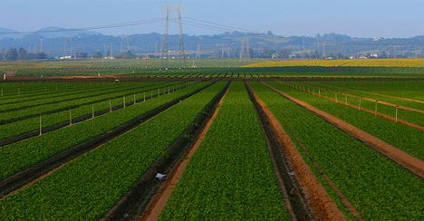
Ecosystem Services and Disservices from Agriculture
Crop monocultures
Benton et al. 2003, Tscharntke et al. 2005, De Fries et 85al. 2010
Notes:
Monoculture are defined by the planting of a single crop species over extensive tracks of land, and characterized by an absence of crop rotation though time. A regional example might be the large tracks of alfalfa grown as fodder throughout the arid south west.
Largely in the north, and increasingly in the global south, traditional and DFS have been replaced with highly simplified industrial monocultures for a number of economic reasons.

Slide 14
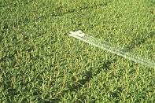
Monoculture: Agro-ecosystem processes
concentration of plant host resources for specialist herbivores;
loss of habitat and decreased diversity and abundance of beneficial arthropods;
decreased biological control of pests;
increase density of specialized herbivore pests;
increased crop loss or damage.
Barbosa 1998; Altier 1995, 1999; Matson et al. 1999; New 2005; Wilkonson and Landis 2005; Zhang et al. 2007; Letourneau et al 2011
Notes:
The agro-ecological consequences of monoculture are the following:
concentration of plant host resources for specialist herbivores;
loss of habitat for natural enemies of arthropod pests;
decreased diversity and abundance of beneficial arthropods;
decreased biological control of pests;
increase density of pests and crop damage.
Simultaneously, the absence of crop rotation through time allows for the build up of both specialized weeds and plant pathogens.

Slide 15
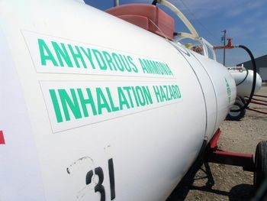
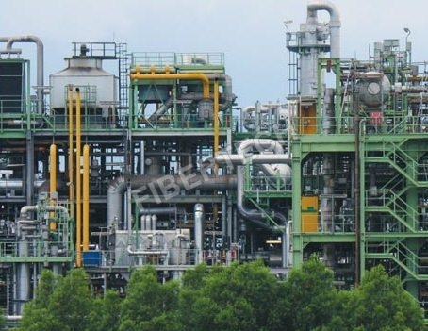
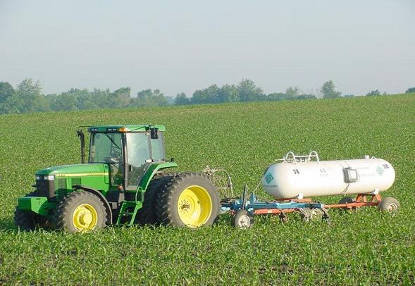
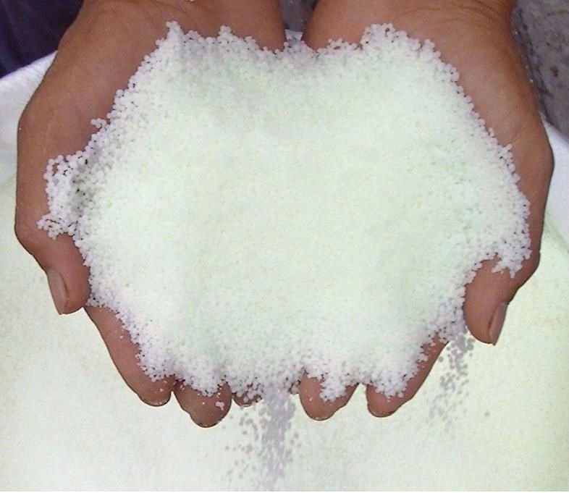
Application of concentrated synthetic nitrogen and phosphorus fertilizer
Notes:
With the advent of the Haber-Bosh process (1910), humans were able to utilize the reservoirs of fossil energy for the production of limiting plant nutrients for agriculture.
Again, for a range of economic reasons, namely the due to the advise of extension agents and to maximize profits, farmers frequently apply more fertilizer than is needed to produce a successful crop.

Slide 16
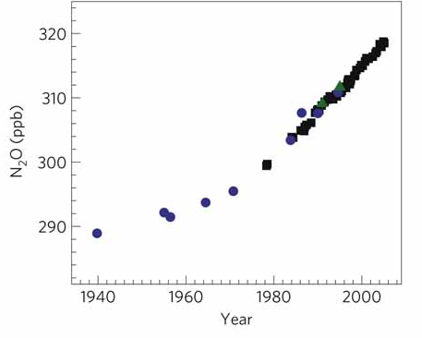
Ecological consequences of the intensive use of mineral fertilizers: nitrous oxide (N20) emissions
Increased fertilizer use over the past 50 years is responsible for a dramatic rise in atmospheric nitrous oxide, a potent (300x) greenhouse gas (Park et al 2012).
Park et al. 2012. Trends and seasonal cycles in the isotopic composition of nitrous oxide since 1940. Nature Geoscience 5, 261–265 (2012) doi:10.1038/ngeo1421
Notes:
University of California, Berkeley, chemists have found a smoking gun proving that increased fertilizer use over the past 50 years is responsible for a dramatic rise in atmospheric nitrous oxide, a potent (300x) greenhouse gas contributing to global climate change.
The report, published in Nature Geoscience, confirms previous assumptions about the role of nitrogen-based fertilizers in the sharp increase in NOx and climate change. Since 1750, atmospheric NOx levels have increased 20 percent, from below 270 ppb to over 320 ppb.
Ozone depletion: nitrous oxide is both a long-lived greenhouse gas and a stratospheric ozone-depleting substance
Nitrogen-based fertilizer stimulates microbes in the soil to convert nitrogen to nitrous oxide at a faster rate than normal.
“Our study is the first to show empirically from the data at hand that the nitrogen isotope ratio in the atmosphere and how it has changed over time is a fingerprint of fertilizer use,”

Slide 17
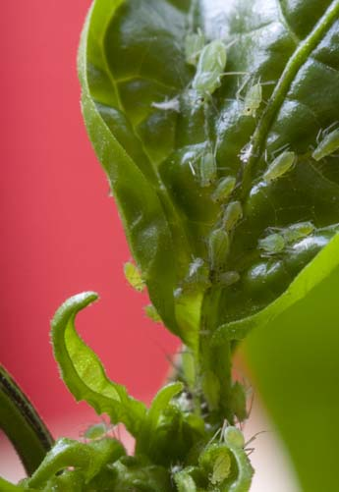
Synthetic Chemical Fertilizer: Agro-ecosystem processes
Changes to crop nutrient status and susceptibility to pests and pathogens
Altieri and Nicholls 2003; Zehnder et al 2007; Garratt, M. P. D., D. J. Wright, and S. R. Leather. "The effects of farming system and fertilisers on pests and natural enemies: a synthesis of current research." Agriculture, Ecosystems & Environment 141.3 (2011): 261-270.
Notes:
Further compounding the problems associated with monoculture, the excessive use of concentrated inorganic N fertilizers, has been shown to change the nutrient composition of crops - change plant growth rates, cell wall composition, increased soluble N levels in plant tissue – and generally decrease herbivore pest resistance.

Slide 18
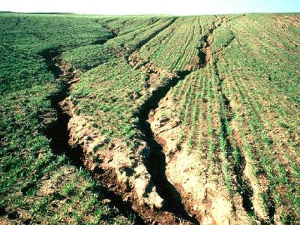

Synthetic Chemical Fertilizer and Intensive Tillage:
Agro-ecosystem processes
Soil erosion and eutrophication
Tilman et al. 2002; Magdoff and Weil 2004
Notes:
Associated with declines in soil quality leads to increase rates of erosion carrying with it N and P fertilizer.
Concentrated N and P fertilizer is easily lost from system through leaching and can enter aquatic ecosystems causing eutrophication, increased BOD, hypoxia and loss of aquatic biodiversity.
N pollution in ground water sources is also a important environmental health issues especially with infants and children.

Slide 19
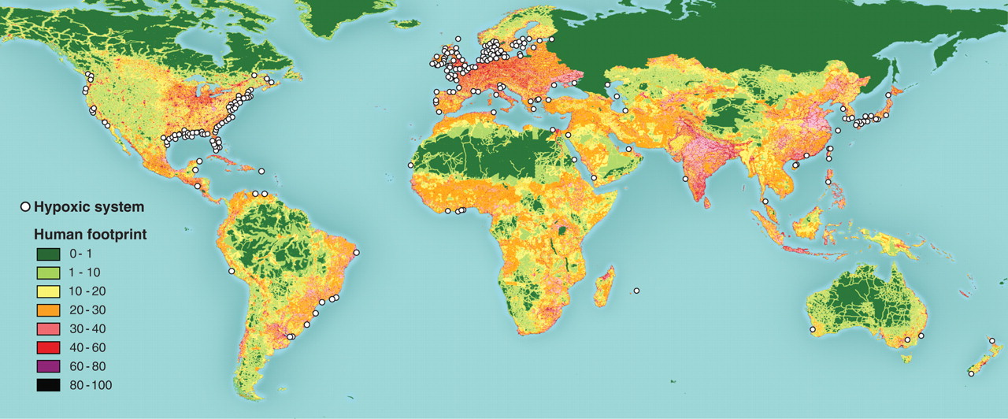
Agroecological Impacts of Agricultural Intensification
Soil erosion, nutrient loss and the eutrophication of the world’s marine ecosystems
Source: Diaz, R. J. and Rosenberg, R. 2008. Spreading dead zones and consequences for marine ecosystems. Science 321(5891):926-929.
Notes:
Dead zones have now been reported from more than 400 systems, affecting a total area of more than 245,000 square kilometers, and are probably a key stressor on marine ecosystems.
N pollution in ground water sources is also a important environmental health issues especially with infants and children.

Slide 20
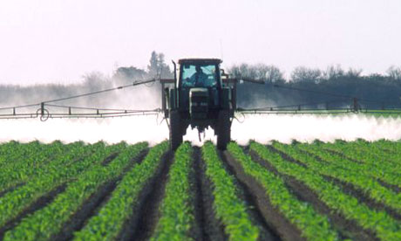
Synthetic chemical pest and weed control
Notes:
Frequently associated with the use of monoculture, excessive chemical fertilizer and the degradation of soil quality is the build-up of pests and pathogens. In response, growers must purchase and apply pesticides to control pest populations.
This has a number of important agroe-cological consequences.

Slide 21
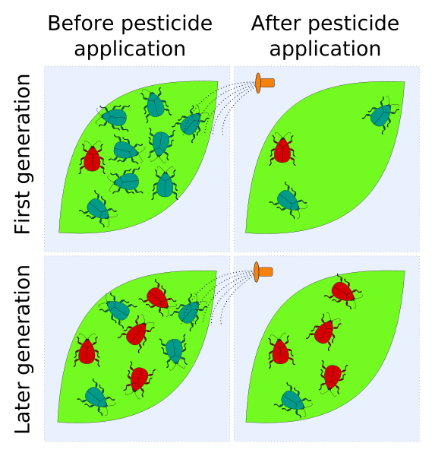
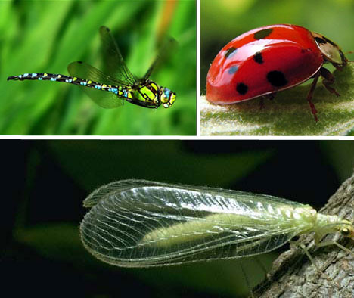
Chemical Pest And Weed Control: Agro-ecosystem processes
Genetic Resistance, Impacts to Non-target Organisms and Pest Resurgence
Vandermeer 2011
Notes:
Pesticide resistance is one of the most well documented examples of evolution through natural selection. The process leads to the what has been referred to as the “Pesticide treadmill.”
Impacts on Non-target Organisms and pest Resurgence occurs simultaneously.

Slide 22
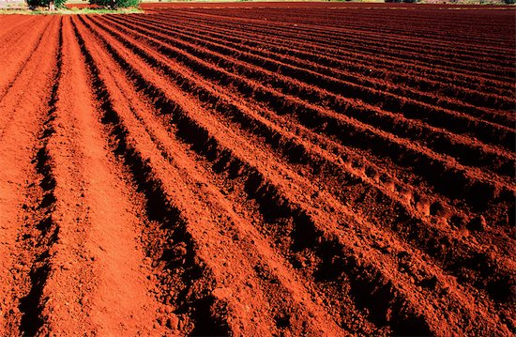
Intensive tillage and bare soil fallow periods
Notes:
Another key characteristic of industrial agriculture is the intensive us of tillage and bare soil fallow periods.

Slide 23
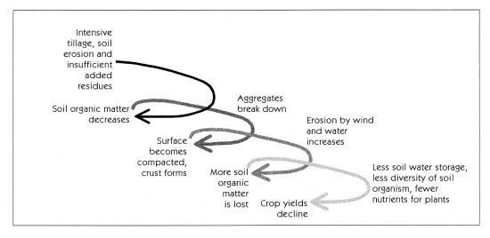
Synthetic Chemical Fertilizer and Intensive Tillage:
Agro-ecosystem processes
Degradation of soil quality
Magdoff and Harold van Es 2000; Magdoff and Weil 2004.
Notes:
The soil degradation process:
The combination of over-reliance on chemical fertilizer, intensive tillage and bare soil fallow has set into motion the following processes in soil ecosystems affecting both environmental quality and the long-term sustainability of the system.

Slide 24
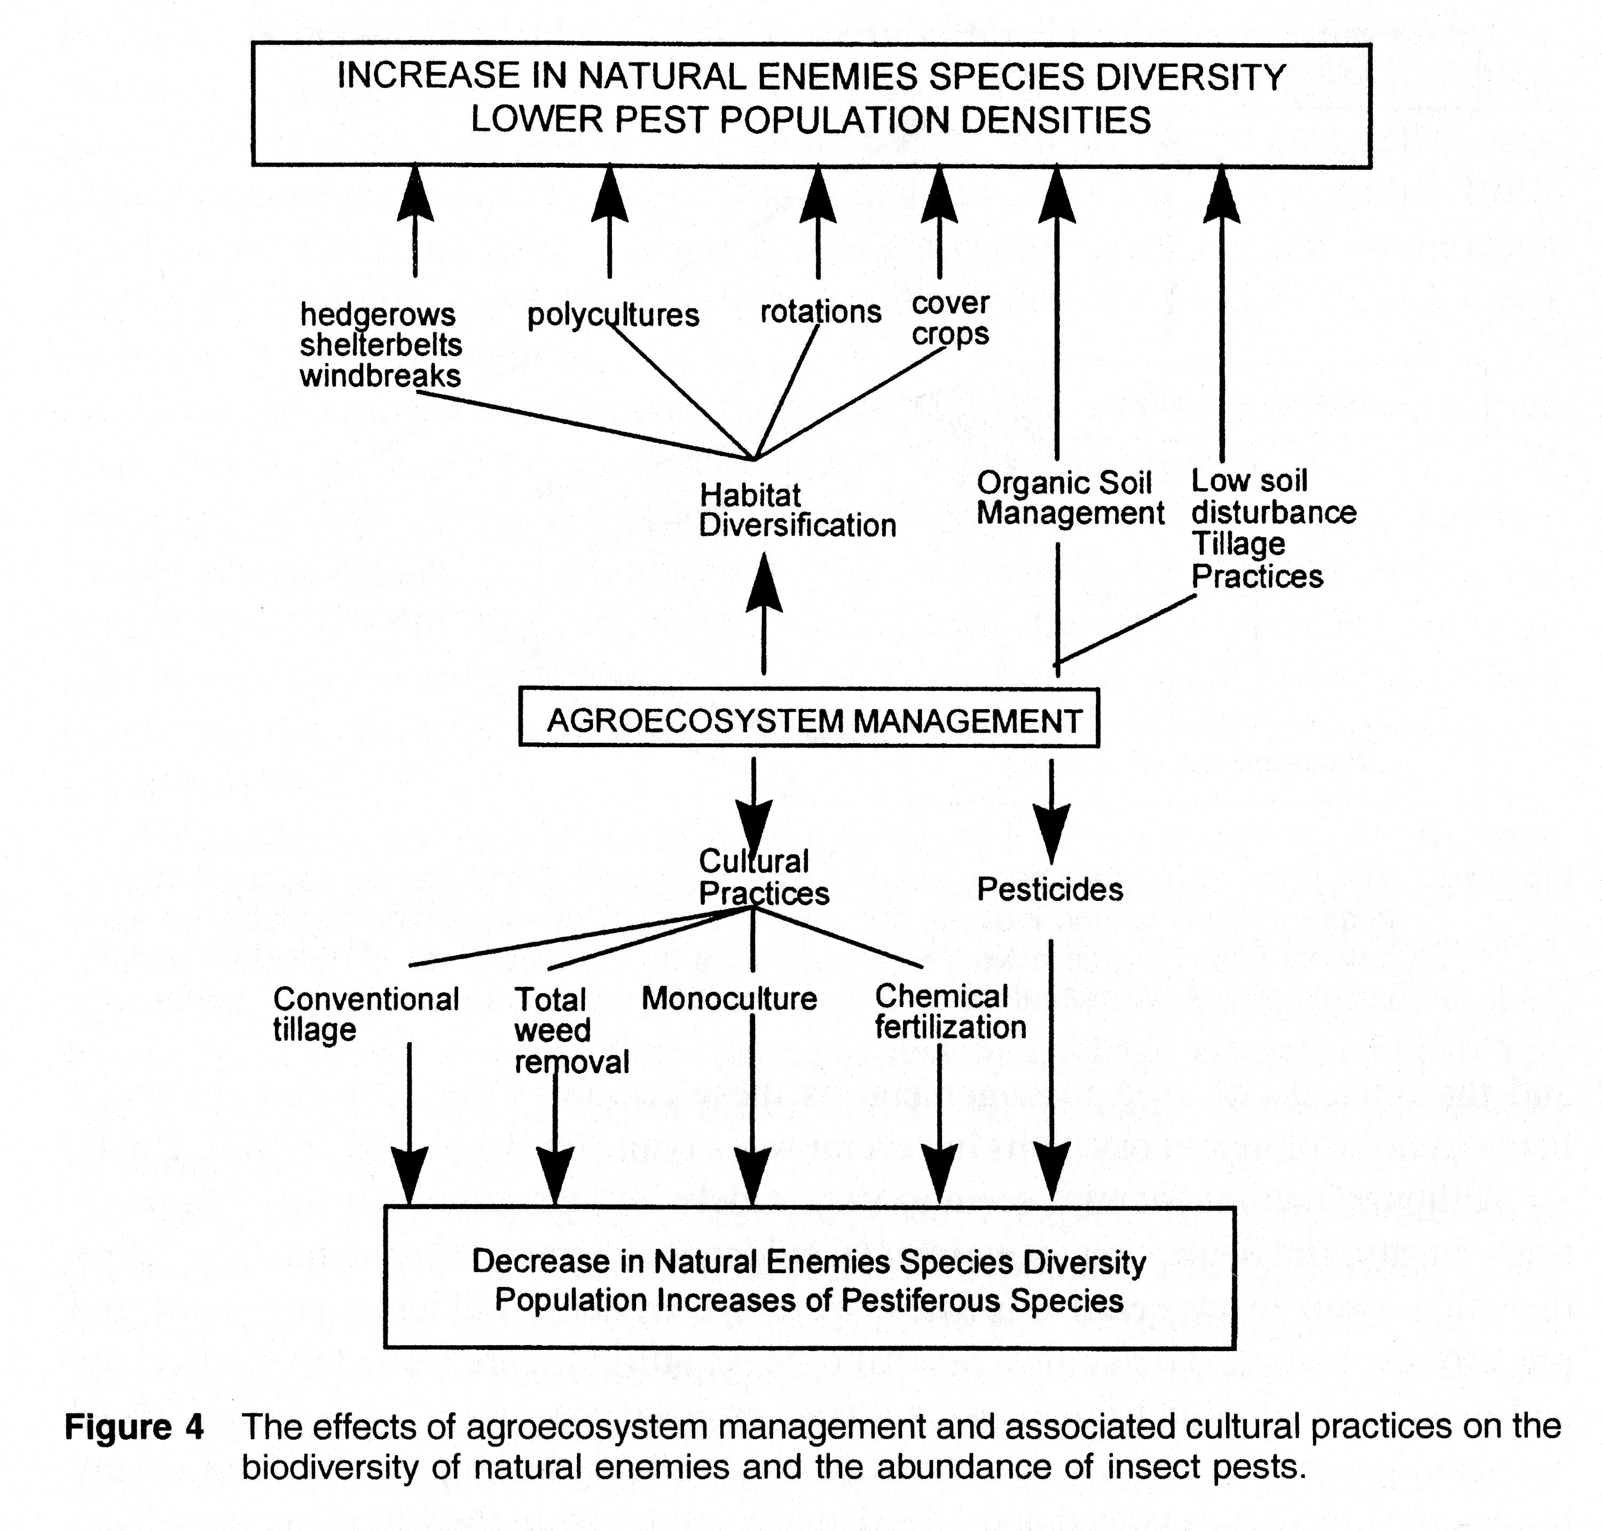
Agroecology: The application of ecological principles to the design and management of sustainable agroecosystesms
Altieri 1995; Altieri and Nicholls 1999; Barbosa 1998; Gliessman 2014
Notes:
Conceptual frameworks emerge from agroecological research describing principles of agroecosystem design and management. A key issue: How to allocated biodiversity and space and time to consistent provide ecological services in specific agroecological contexts.
Drawing upon the understanding of the functioning of traditional and diversified farming system the idea of functional diversity.

Slide 25
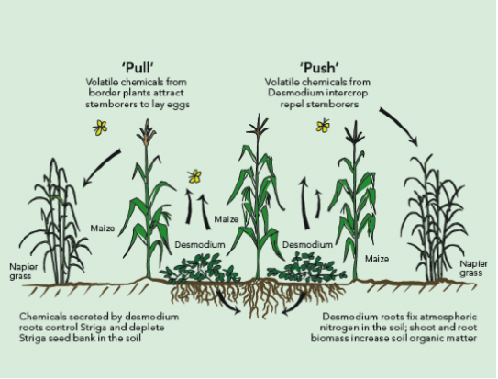

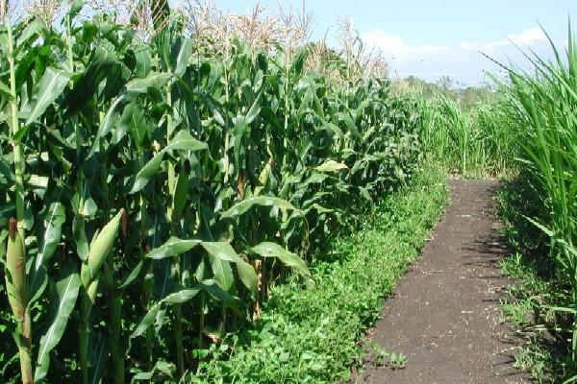
Case Study in Agroecology:
The ‘push-pull’ system in East Africa
Altieri 1989; Khan et al. 2011; Cook et al. 2007
Notes:
Researchers worked in East Africa for the last fifteen years to develop an agroecological pest management solution for stem borers and striga weed, two major pests of maize and sorghum, crops on which millions of the poorest people in eastern and southern Africa rely (Khan et al. 2011). Yield losses to stem borers typically range from 20-40% but can reach 80% while losses from striga are even higher, and when these pests co-occur, farmers can lose their entire crop (Khan et al. 2000). The push-pull method (PP) developed by researchers manages stem borer pests through a stimulo-deterrent chemical ecology strategy. Selected fodder species (Desmodium spp) and wild grasses are intercropped in maize fields to “push” stem borer pests from the system, while other grasses are used as trap crops to “pull” the stemborers away, protecting the crop from infestation (Shelton and Badenes-Perez 2006). Intercropped plants not only repel stemborers but also attract natural enemies can further decrease stem borer densities by enhancing parasitism rates (Khan et al. 1997). Two leguminous plants, Desmodium uncinatum and D. intortum, are also intercropped; these fix nitrogen and produce root exudates that limit the reproductive success of striga weed (Khan et al. 2000). In addition to enhancing crop yields, the PP strategy has been shown to improve small livestock production, conserve soil resources, enhance functional biodiversity, and increase incomes and women’s empowerment (Khan and Pickett 2004). As of 2010, the push-pull system has been adopted by over 30,000 smallholder farmers in east Africa, where maize yields have increased by 1-3.5 t/ha, on average, with minimal external inputs (Khan et al. 2011).

Slide 26

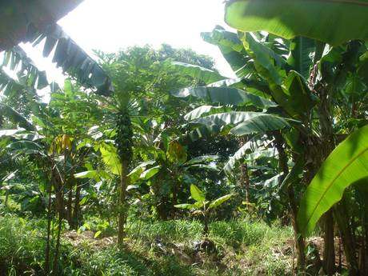
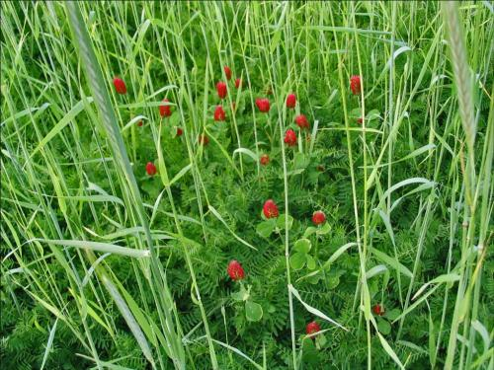

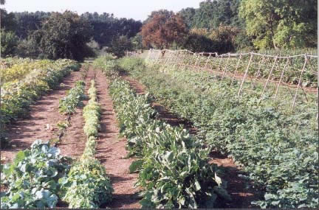
Comparing Biologically Diversified with Conventional Farming Systems: what is known about the tradeoffs among crop productivity and ecosystem services?
Kremen, C., & Miles, A. (2012). Ecosystem services in biologically diversified versus conventional farming systems: benefits, externalities, and trade-offs. Ecology and Society, 17(4), 40.
Notes:
There is a need to clearly ID which types or farming systems will produce the greatest amount of mitigation and allow the greatest amount of adaptation to climate change.
I would therefore like to present a summary of our recent paper in Ecology and Society measuring the environmental performance of organic and biologically diversified farming systems and conventional systems.
Here we examine the ecological benefits of using biologically diversified farming systems, as well as their potential to mitigate environmental externalities of conventional farming systems and their ability to contribute to global food security as world population rises to 9 billion.

Slide 27
Objectives & Scope of Paper
Rationale: To provide a global quantitative summary of a representative scientific literature measuring differences in the provisioning of important ecosystem services (ES) to and from biologically diversified as compared to conventionally managed and biologically simplified farming systems.
Ecosystem services assessed in the study:
  Biodiversity
  Soil quality enhancement
  Water use efficiency
  Control of weeds, diseases and arthropod pests
  Pollination services
  Carbon sequestration
  Energy use
  Global warming potential
  Resistance and resilience to severe weather conditions
  Food productivity/yield

Slide 28
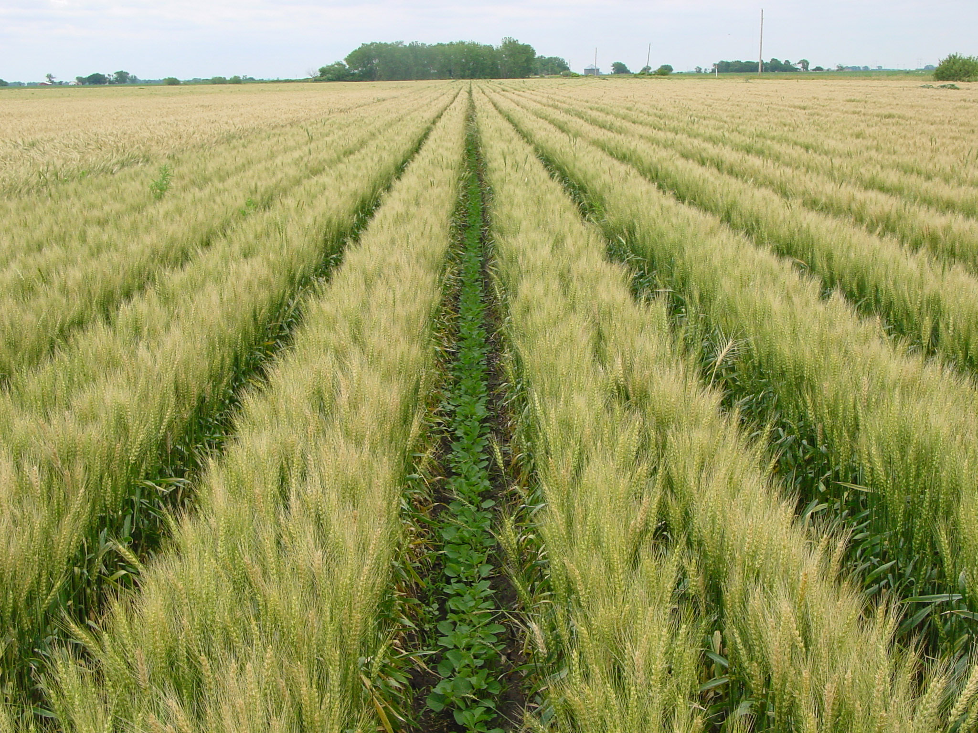
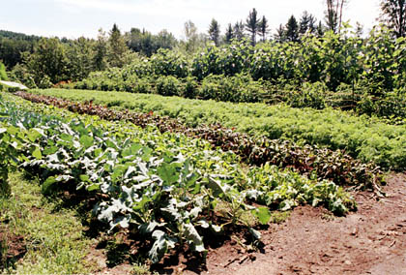
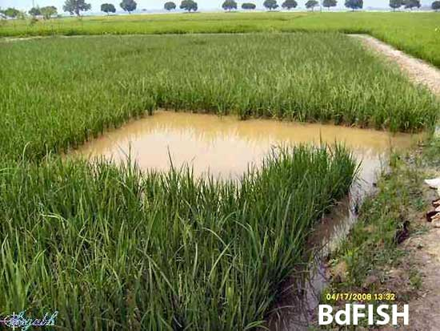
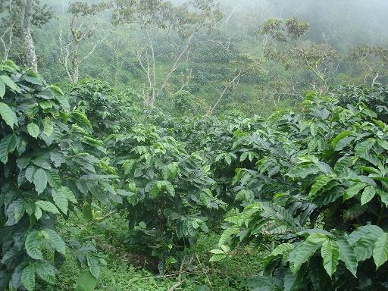
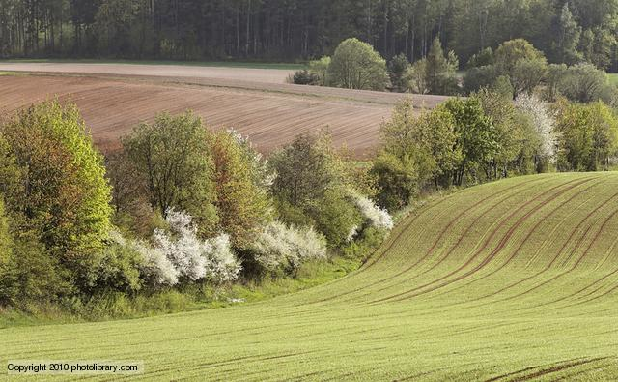
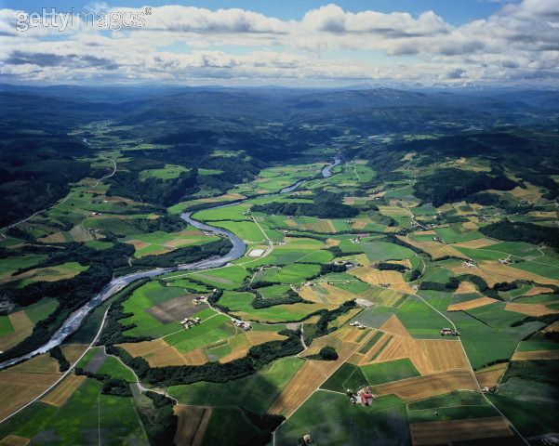
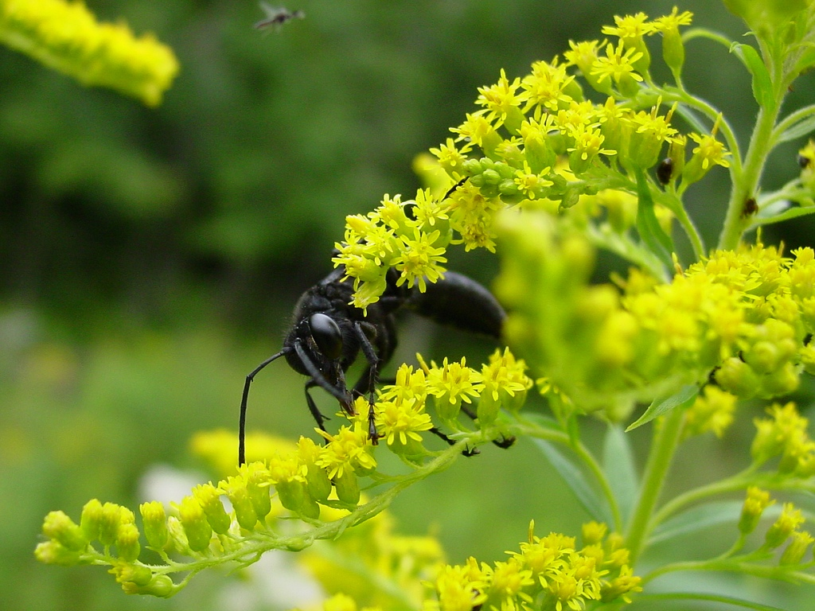

Slide 29
Classification of Findings on Diversified Farming Systems and Ecosystem Services
Summary Table:
  ‘Strong Effect’: > 25% change and (p<0.05)
  ‘Weak Effect’: < 25% change, OR weak significance (p>0.05)
  ‘Equivocal’: data indicate no clear trend at present resulting from too few studies conducted to clearly determine trend in data.
Findings key:
  Positive Findings (X) = diversified farming practices provided greater benefits for the service or indicator than conventional practices.
  Negative Findings (X) = diversified farming practices provided fewer benefits for the service or indicator than conventional practices.

Slide 30
Summary: Biophysical
Service | Equivocal | Weak Effect | Strong Effect
Soil Quality [SOM, physical, biological characteristics, erosion reduction] |  |  | x
N leaching [org-conv comparison] |  | x
P leaching [org-conv comparison] | x
N + P leaching [riparian buffer] |  |  | x
Water use efficiency |  |  | x
Strong Effect: >25% change
Weak Effect: < 25% or weak significance
Equivocal: NS or too few studies conducted

Slide 31
Summary: Biotic interactions
Service | Equivocal | Weak Effect | Strong Effect
Biodiversity [abundance, richness of arthropods, plants & birds] |  |  | x
Control of Weeds |  |  | x
Control of Plant Pathogens - aerial - soil |  | x | x
Control of Arthropod Pests -local scale -landscape scale | x | x
Pollination Services |  | x
Strong Effect: >25% change
Weak Effect: < 25% or weak significance
Equivocal: NS or too few studies conducted

Slide 32
Summary: Climate change adaptation (A) & mitigation (M)
Service | Equivocal | Weak Effect | Strong Effect
Carbon sequestration (M) |  |  | x
Energy use (M) |  |  | x
Global warming potential (M) | x
Resilience to drought (A) |  |  | x
Resistance to hurricane (A) |  |  | x
Strong Effect: >25% change
Weak Effect: < 25% or weak significance
Equivocal: NS or too few studies conducted

Slide 33
Yield/Productivity
Service | Equivocal | Weak Effect | Strong Effect
Yield Developed country (org-conv) Developing country (DFS – “resource poor”) |  | x | x
Strong Effect: >25% change
Weak Effect: < 25% or weak significance
Equivocal: NS or too few studies conducted
Ponisio, L. C., M'Gonigle, L. K., Mace, K. C., Palomino, J., de Valpine, P., & Kremen, C. (2015). Diversification practices reduce organic to conventional yield gap. Proceedings of the Royal Society of London B: Biological Sciences, 282(1799), 20141396.

Slide 34
Conclusions
Substantial evidence of significant advantages to ecologically based and BDFS for the following ecosystem services:
  biodiversity conservation;
  control of arthropod pests, weeds and diseases;
  pollination services;
  soil quality enhancement and maintenance;
  water use efficiency, carbon sequestration;
  Increased energy use efficiency;
  Increased resistance and resilience of farming systems to extreme weather events.
  Reduced nutrient losses (N)

Slide 35
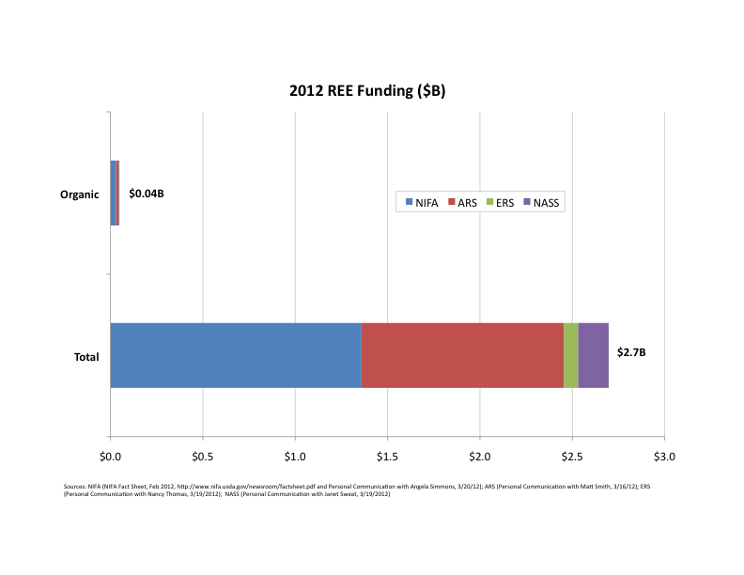
Conclusions
Organic farming systems and agroecology receive 1.68 – 4.1% of total USDA Research, Education & Extension funding (Carlisle & Miles 2013; Delong et al. in preparation)

Slide 36
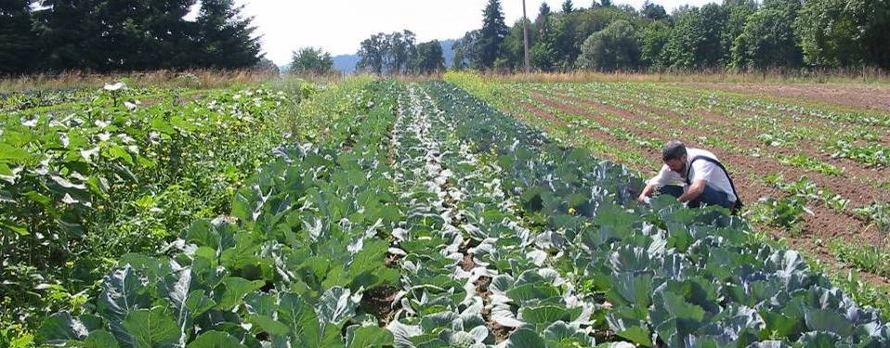
Conclusions
With significant public investment in agro-ecological research, education and extension, society would realize even greater social and ecological performance from biologically diversified farming systems while mitigating and adapting to global climate change.
Notes:
Doing so would bringing us closer to the realization of global food security while preserving biodiversity and other ES essential to the health and well being of all.

Slide 37
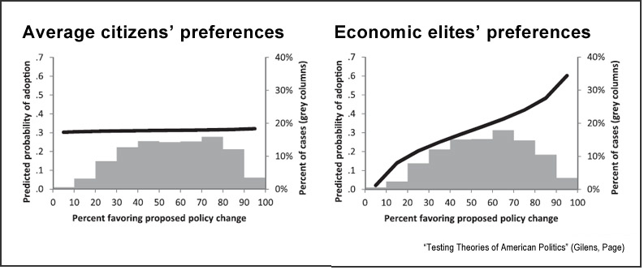
Industry Capture of Political Process
Gilens, M., & Page, B. I. (2014). Testing theories of American politics: Elites, interest groups, and average citizens. Perspectives on Politics, 12(03), 564-581.
Notes:
Citizens United v. Federal Election Commission (2010) Campaign Finance Law - a US constitutional law case, in which the United States Supreme Court held that the First Amendment prohibits the government from restricting political independent expenditures by corporations, associations, or labor unions.
McCutcheon v. Federal Election Commission Campaign Finance Law (April 2, 2014) - The Supreme Court on Wednesday continued its abolition of limits on election spending, striking down a decades-old cap on the total amount any individual can contribute to federal candidates in a two-year election cycle

