Slide 1
Exploring North Korea’s nuclear technology transfer efforts through its trade networks
Justin V. Hastings
Department of Government and International Relations
University of Sydney
2 March 2015
Seoul National University
Institute for Peace and Unification Studies

Slide 2
Dueling narratives
Kevin Rudd, 2011
Kevin Rudd, 2011
[North Korea is] “reclusive, isolated, and paranoid…a throwback to a former era. A bizarre mix of 1984-style state control, personality cult, whacky ideology, and military bravado.”
“We should not be lulled into a false sense of security by the dire state of the country's economy. In fact, North Korea's weapons programs are a source of funding for the regime. It sells its weapons secrets for hard currency that keeps the regime's coffers stocked.”

Slide 3
Questions
Seeming paradox: One of the world’s last Stalinist states is also one of its most enterprising. It is surprisingly entrepreneurial and adaptable when tapping into global economic networks as a means of survival.
  What explains the relative effectiveness of North Korea’s trade networks, particularly in the face of international hostility to that trade?
What can studying North Korea’s global trade networks tell us about the DPRK’s nuclear technology transfer networks, especially its efforts to acquire nuclear and dual-use goods?

Slide 4
Answers (North Korean trade networks)
North Korean trade networks are ruthlessly pragmatic and adaptable, operating with something approaching Darwinian economic logic, as if their survival is at stake, because it often is.
  Survival of all actors is dependent on entrepreneurialism
  Able to operate overseas through the creative use of support networks
North Korean trade networks’ relationship with the North Korean state and the institutional environment in which they operate encourage strategies for integration into the global economy
  Hostile institutional environments → adept at blurring, shifting between formal/informal, state/non-state, licit/illicit environments
  Adept at navigating environments not of their making
  Diversified markets, opportunistic in business dealings
Hostile environments may actually make North Korean traders operate more effectively

Slide 5
Answers (Nuclear technology transfer networks)
The structure of trade networks and technology transfer networks are fundamentally similar
  DPRK nuclear technology transfer networks use many of the same methods and routes
  Brokers and suppliers for trade networks and sanctioned goods are often the same
DPRK nuclear technology acquisitions networks have adapted to foreign state hostility in creative ways
  Shifting main transshipment point over time
  Becoming more integrated into global economy through access to outside brokers, trade networks closer to North Korea
  Reduced use of state assets outside of North Korea

Slide 6
Dimensions of global value chains (Gereffi et al)
Input-output structure
Governance structures
Institutional framework
Processes of inputs and outputs (supply, production, distribution, retail)
Territorial locations and extent of GVC nodes
Nature of nodes
Relationships between nodes
Location of value capture
Geographic scope
Political and economic conditions under which GVC operates

Slide 7
Technology (materials) transfer
 | State
Technology transfer (logistical) | Internationalization of the network Nationalities of brokers Extrusion of state brokers into other countries
 | Characteristics of the network Nature of relationships within the network Structure of the network Materials transported Choice of countries for acquiring and transporting different types of goods
 | Context for the network Place of chosen broker locations in global economy Attention of broker countries to countering proliferation

Slide 8
North Korean trade networks

Slide 9
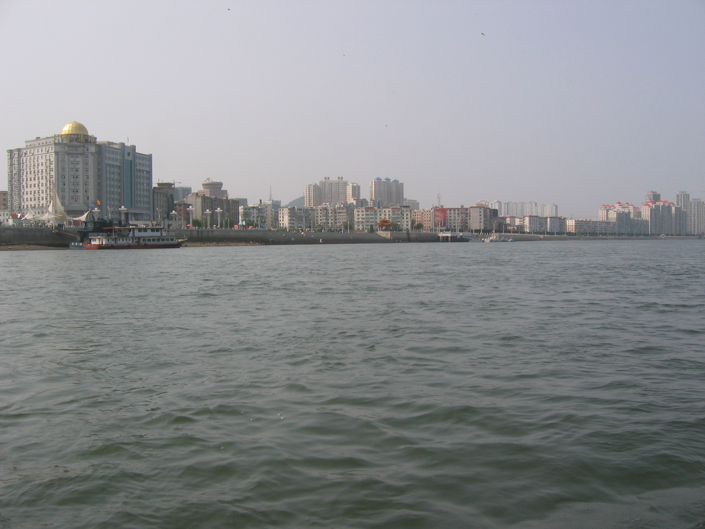
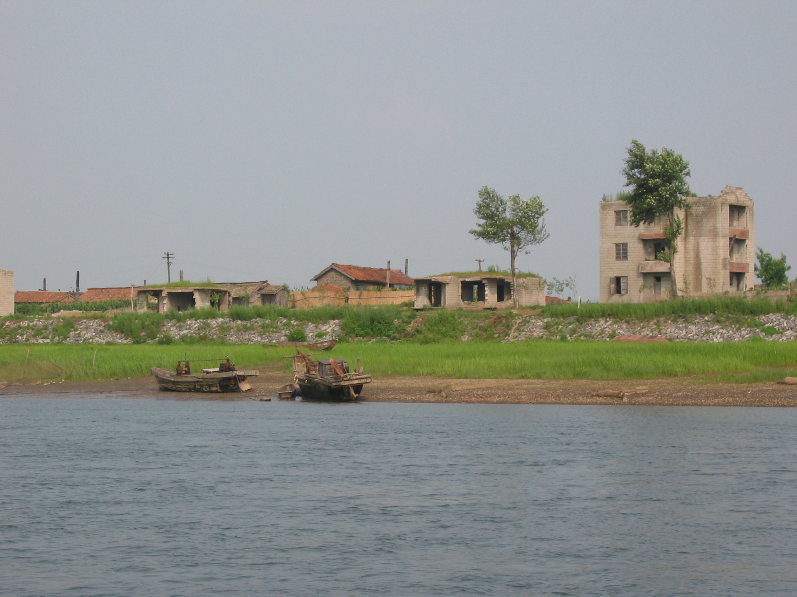
A Tale of Two Cities
Dandong
Sinuiju

Slide 10
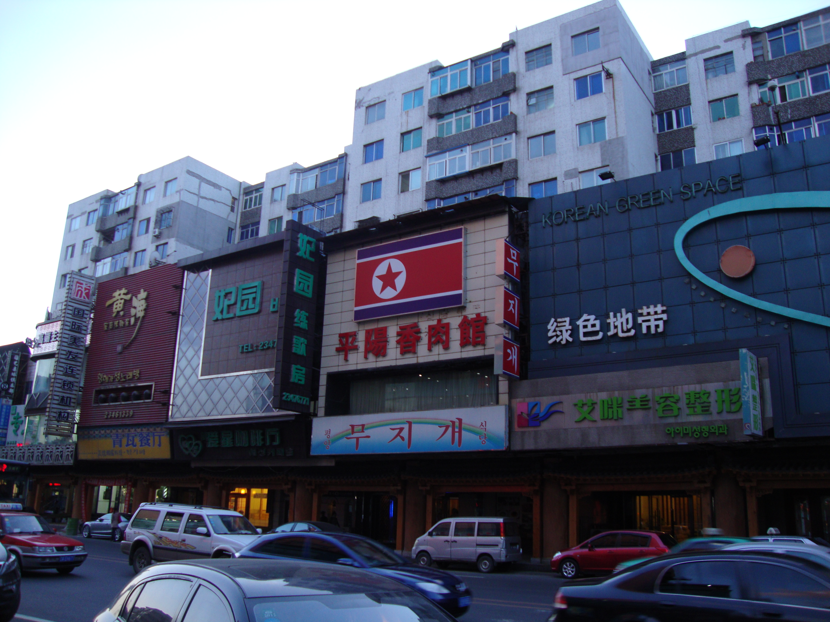
North Korean entrepreneurialism

Slide 11
Successful DPRK trade through blurring categories
Formal
Informal
State
Non-state
Licit
Illicit

Slide 12
Actors in North Korean trading networks
Central state
State trading entities
Private traders (won)
Private traders (hard currency)
Hybrid entities (moonlighting state officials, red hat enterprises, public/private partnerships)
Access to state resources and prerogatives

Slide 13
Actors in North Korean trading networks
Central state
State trading entities
Private traders (won)
Private traders (hard currency)
Hybrid entities (moonlighting state officials, red hat enterprises, public/private partnerships)
Access to state resources and prerogatives

Slide 14
The role of state prerogatives and resources
Blessing for the central state
Curse for the central state
Allow trading networks with access to them to:
  (1) operate across wider area
  (2) capture value further from North Korea
Allow for formal, fluid adaptation outside of North Korea
Friendlier institutional environment inside of North Korea
Draw the hostile attention of sanctions enforcers, even of otherwise licit transactions
Limited by territorial distribution of overseas state assets
Private actors seem to be better able to tap creatively into global networks than top-down networks

Slide 15
North Korean acquisition process
Dandong case study (2013)
Bank accounts
- NK bank branches in China
- Trusted partners in China
- NK shell company accts in SEA, China
North Korean buyer
North Korean broker
North Korean customs
Chinese trading company
Chinese customs
Partner Chinese
trading company
Suppliers

Slide 16
North Korean acquisition process
Dandong case study (2013)
Bank accounts
- NK bank branches in China
- Trusted partners in China
- NK shell company accts in SEA, China
North Korean buyer
North Korean broker
North Korean customs
Chinese customs
Suppliers

Slide 17
North Korean nuclear technology (inbound) transfer networks

Slide 18
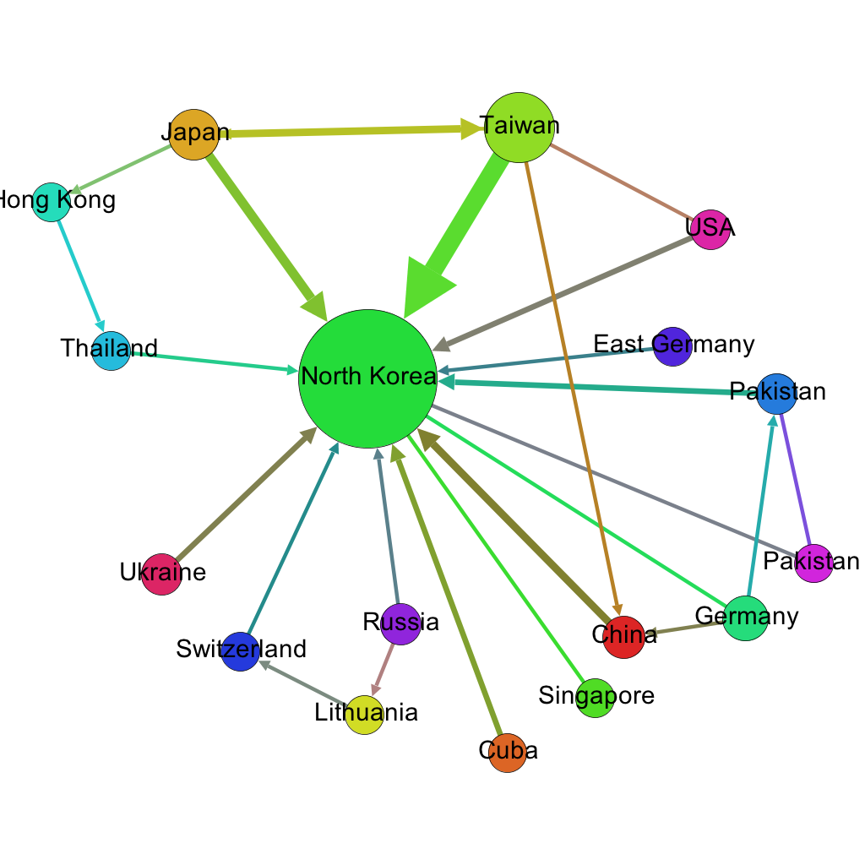
North Korea networks:
Group Location

Slide 19
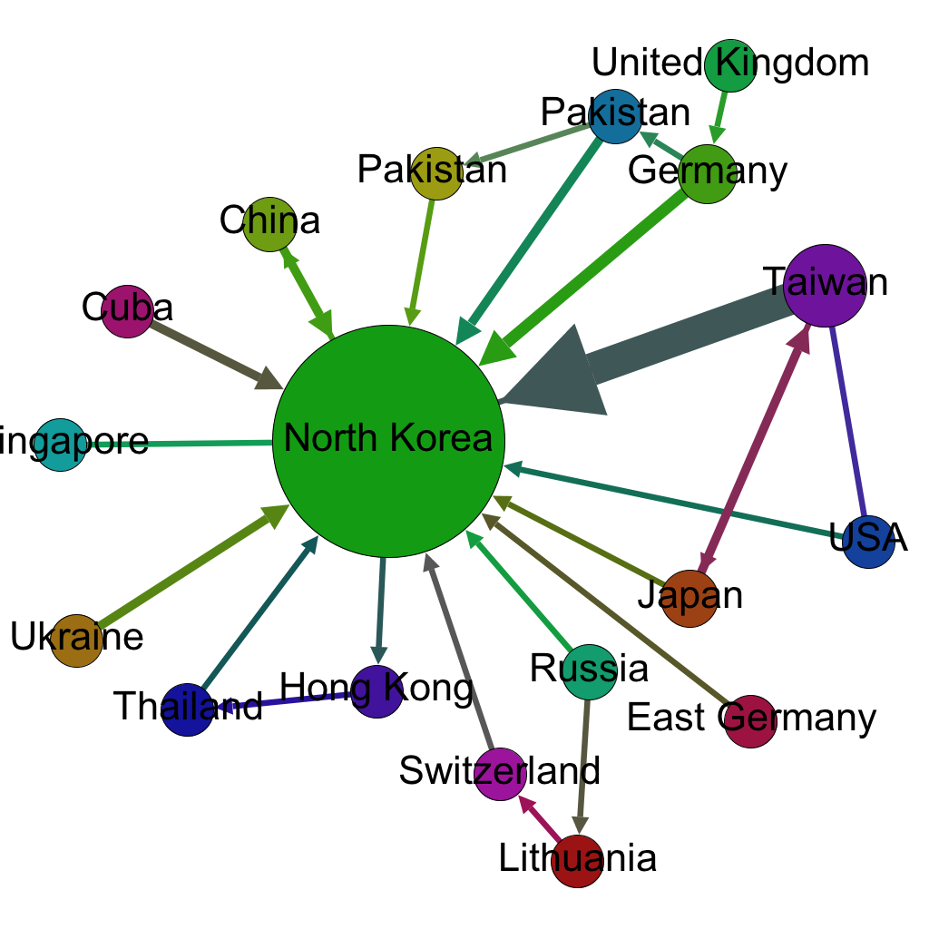
North Korea networks:
Nationality of individuals

Slide 20
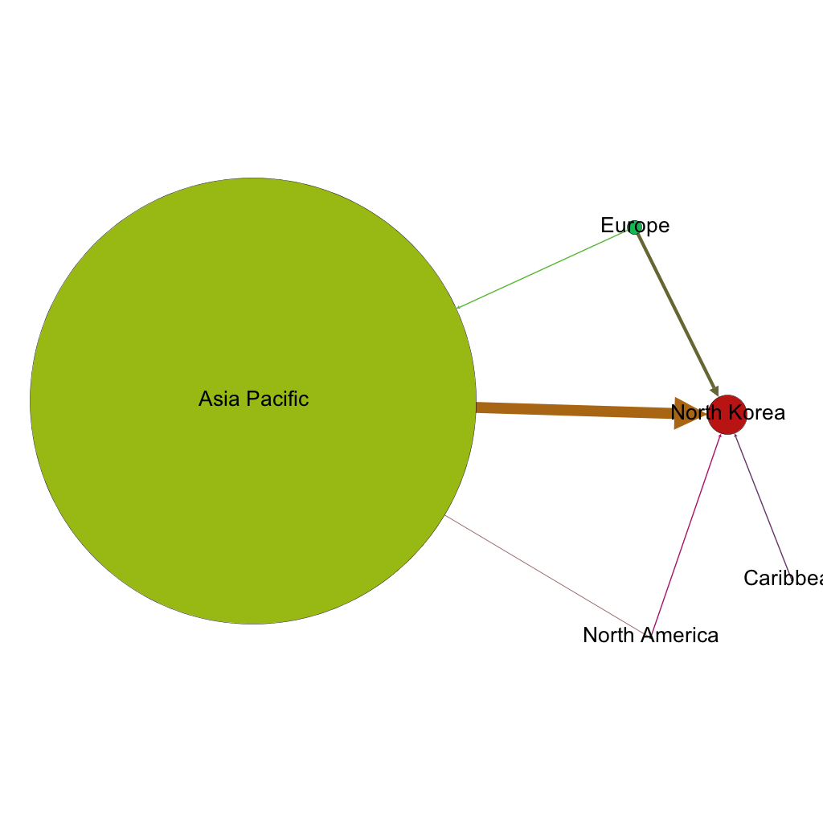
North Korea networks:
Group Location Region

Slide 21
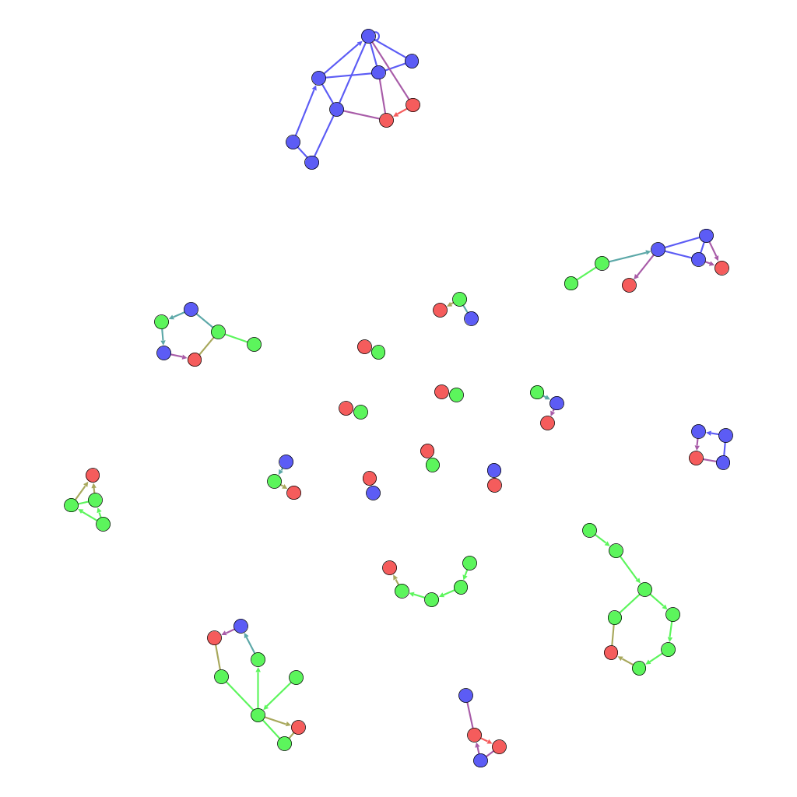
North Korea network:
Group Location NSG membership status
(Blue = Non-NSG; Red = North Korea; Green = NSG)

Slide 22
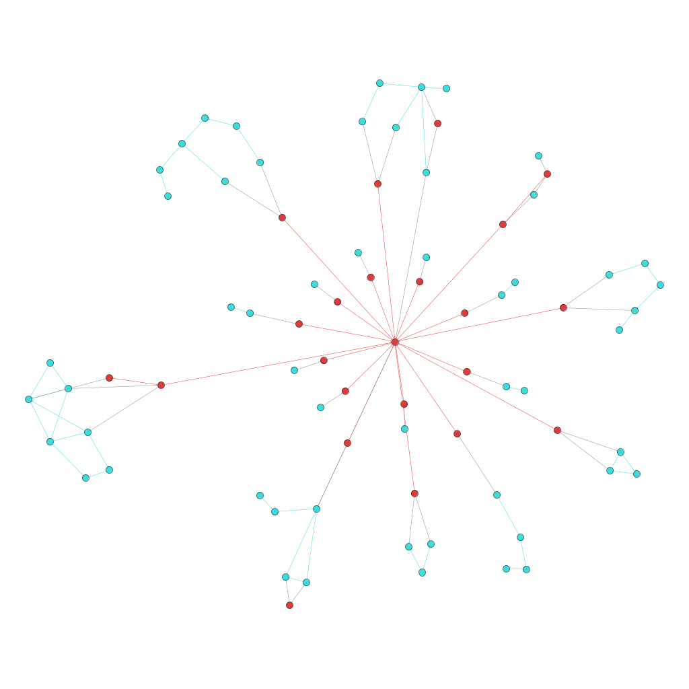
North Korea: Technology transfer network - Networks by group location
(North Korea = red, others = blue) with North Korea dummy node at the center

Slide 23
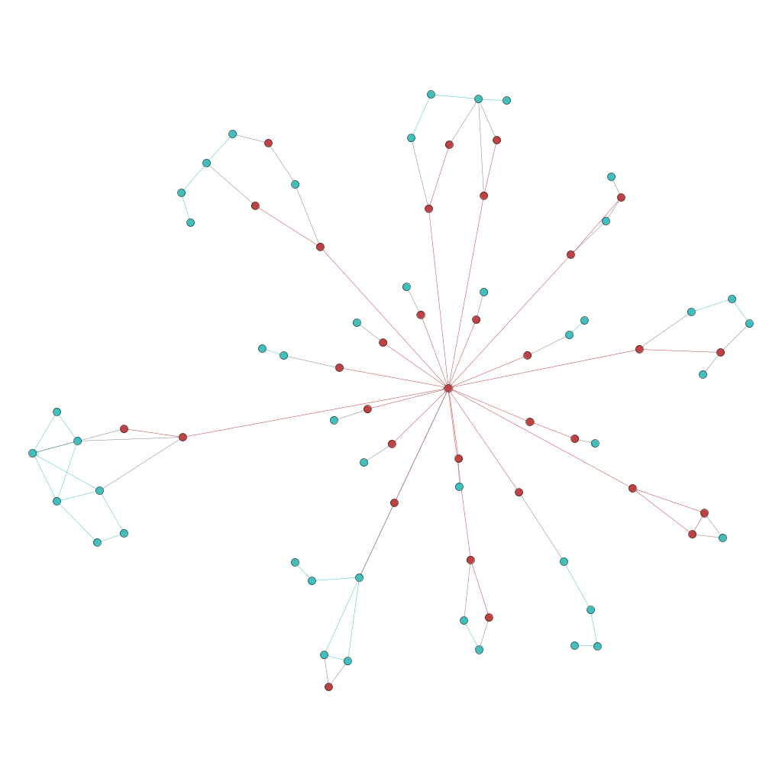
North Korea: Technology transfer network - Networks by individual nationality
(North Korea = red, others = blue) with North Korea dummy node at the center

Slide 24
North Korea technology transfer network:
Initial findings
Composition and location of nodes
Producers and transit points split between Nuclear Suppliers Group and non-Nuclear Suppliers Group countries (more so than Iran)
  Concentration in Asia Pacific and Europe
Dominant suppliers and brokers were in same region as North Korea
  Function of nodes with non-market relationships?
  Suppliers relatively sticky over time
Brokers were often either North Koreans or sympathetic to North Koreans, although not to the same extent as Iran
  North Korea was, if anything, more open to market relationships
North Korea shifted dominant brokers over time
  Japan before 2006, Taiwan after 2006, China in recent years
  Surrounded by technologically advanced countries that were well integrated into the global economy, largely indifferent to its activities

Slide 25
North Korea technology transfer network:
Initial findings
Edge/ties characteristics
While the brokerage networks became complex, there were mostly relatively simple routes between sellers and North Korea
  Use of masking strategies and foreign brokers rather than complex transportation routes
Reliance on licit methods for transportation → reliance on global commercial shipping networks
  Exception: final segment to North Korea, which often uses North Korean state resources and prerogatives
Network Structure
Lack of use of state prerogatives outside of North Korea → fairly centralized logistical structure through commercial transit points
  BUT shift over time in places where network was centralized

Slide 26
Questions, Comments or Criticisms?
For copies of the manuscript, please email: justin.hastings@sydney.edu.au

